Slide 1
University of Pittsburgh
Institutional Biosafety Division
IBC Protocol Requirements, Workflows, and Timelines
Kristine Cihil, MPPM, MSL
Institutional Biosafety Division Staff

Slide 2
Agenda
Who needs an IBC protocol
Why is it needed
How to gain access to MyIBC
Filling out the online application
Initial submittal and review processes
Getting to Approval
Post- Initial Approval
Updating personnel
Updating materials and work
Annual Renewals
Other Topics
Stem Cell Approval (hSCRO)
HGT protocols
Incident Reports
“EHS only” IBC protocols
Biosafety Manuals
Laboratory Inspections
IACUC linking

Slide 3
Who needs IBC approval
Transgenic animals
Viruses
Tissues and Cell Lines (all species)
Plasmids/BACs
Bacteria/Yeast
In Vivo w/ rDNA materials
Any research that involves recombinant (rDNA) or synthetic nucleic acid technology

Slide 4
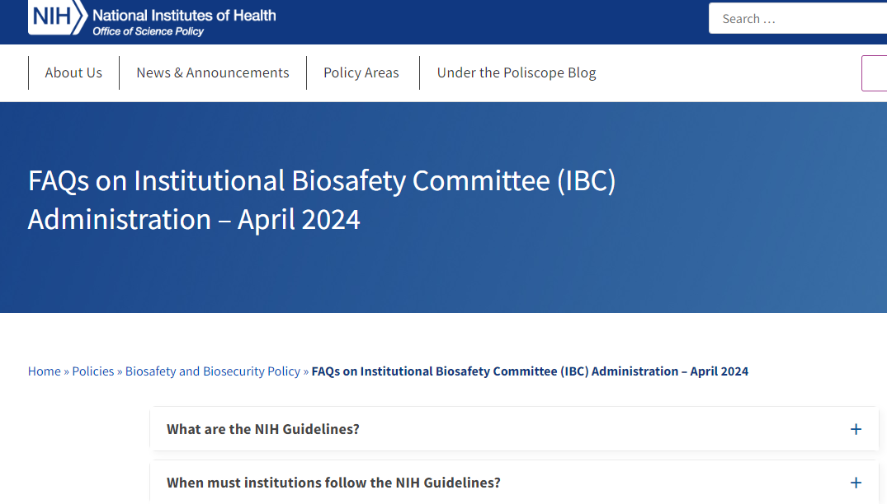
Why is it needed
NIH Office of Science Policy Guidelines state:
An institution must follow the NIH Guidelines if it receives any funding from the NIH for research involving recombinant or synthetic nucleic acid molecules. Even if only one research project involving recombinant or synthetic nucleic acid molecules at an institution benefits from NIH support, all such projects conducted at or sponsored by that institution must comply with the NIH Guidelines. Also, adherence to the NIH Guidelines may be a condition of support from other federal agencies, or even private funders of research.
FAQs on Institutional Biosafety Committee (IBC) Administration – April 2024 - Office of Science Policy

Slide 5
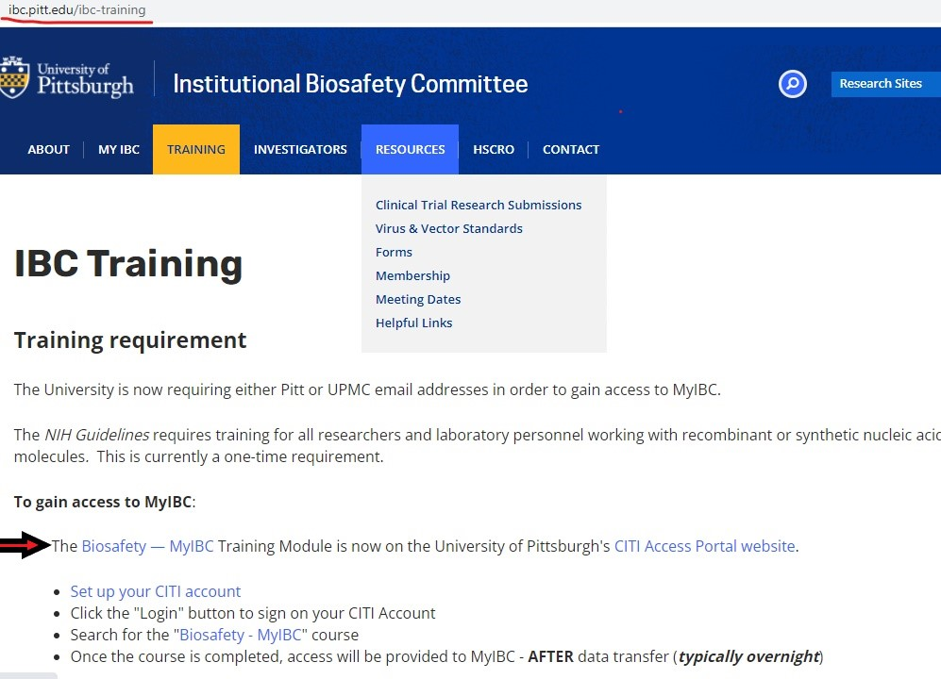
How to get access to MyIBC
Video Training Session 1 and 8
www.ibc.pitt.edu/ibc-training

Slide 6
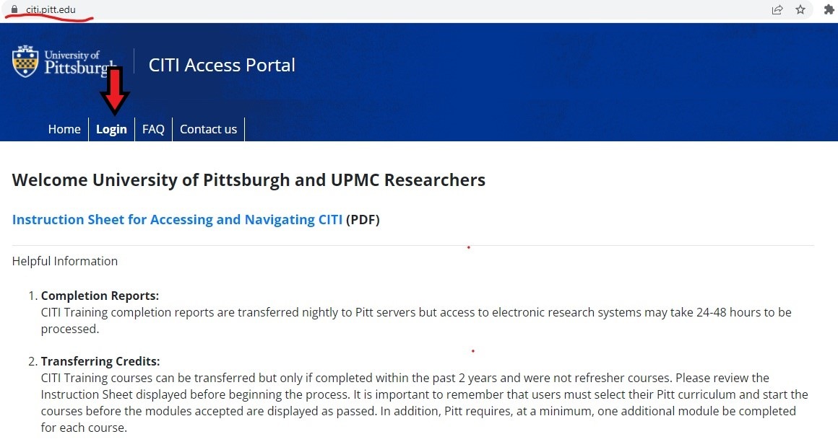
CITI Training Platform
www.citi.pitt.edu

Slide 7
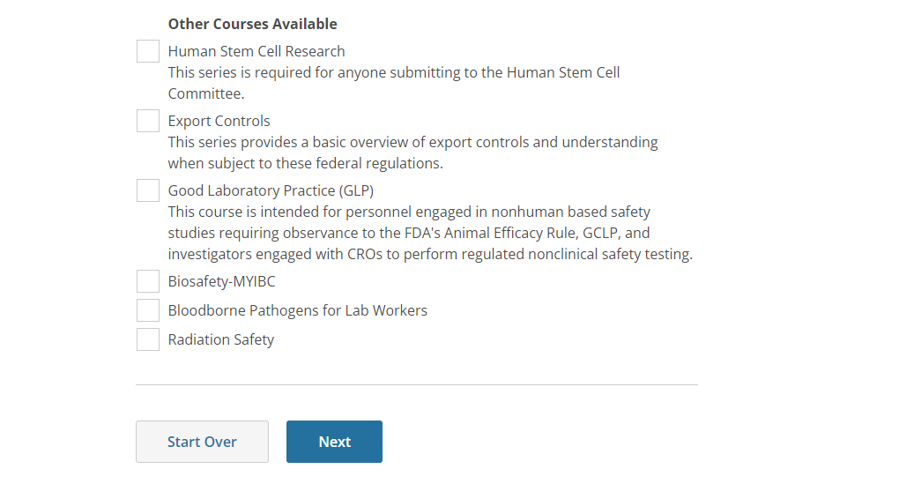
Select and Complete
Univ of Pittsburgh/Add a Course

Slide 8
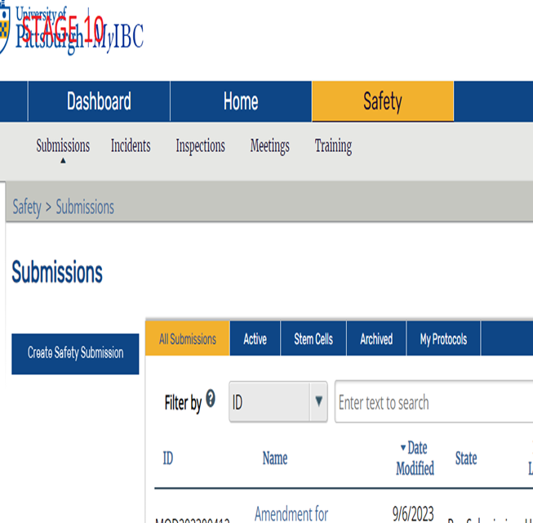
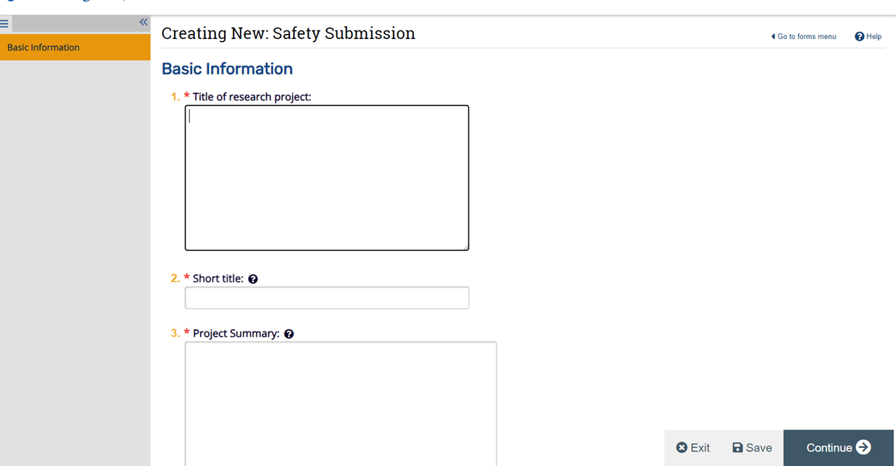
Filling out the online form in MyIBC myibc.pitt.edu
Video Training Session 2

Slide 9
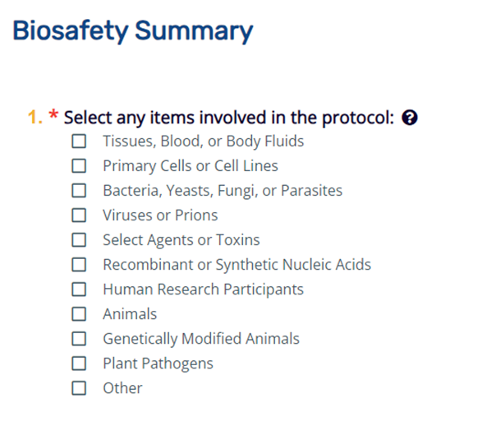
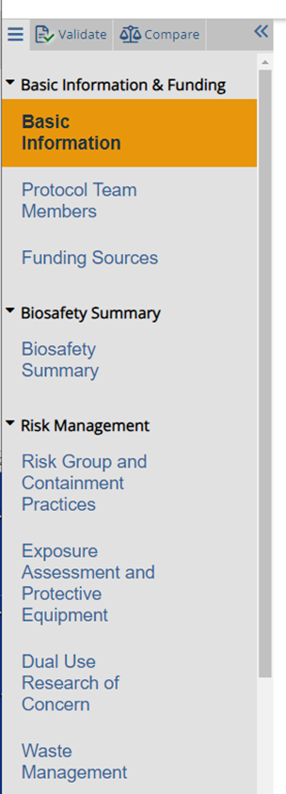

Branching Format

Slide 10
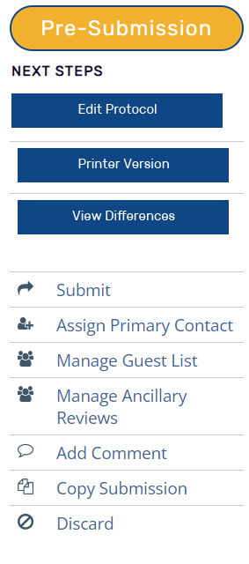

Once submission is completed
Notes:
Listed personnel can view and edit, but only PI can submit

Slide 11
Workflow: Submission to Approval
PI Submits
PI addresses office comments
PI addresses initial member comments
PI addresses final member comments
Office Review
Office manages Member Review
IBC convened meeting
Office final review
Committee Member
APPROVAL

Slide 12
Questions?

Slide 13
Post Approval Modifications/Amendments
Video training sessions 3, 4, 5, and 6
Amendments
Update materials
Update related protocols
Update personnel
Update funding
May result in office review, member review, full committee review
Timeline for approval? It depends...
New materials, clarity of descriptions, responsiveness of study team
Annual (Continuing Reviews)
Yearly acknowledgement of work ongoing
Can also make changes (via an Amendment)

Slide 14
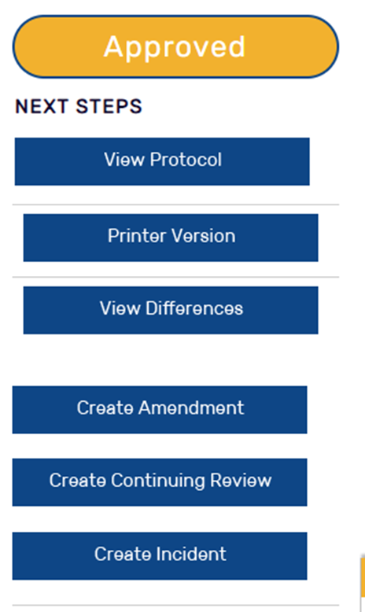
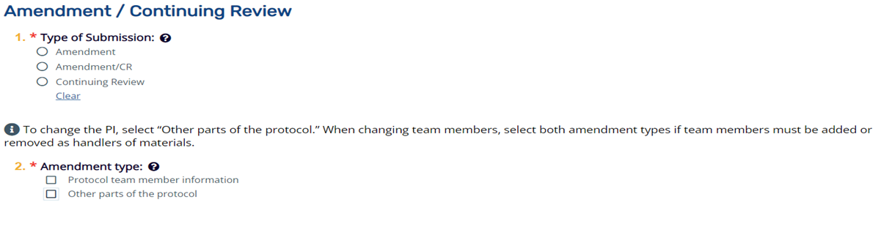
Amendment/Continuing Review
There are 3 types of submissions, 2 types of amendments
Amendment–to make any changes to the protocol.
Amendment/CR- to make any changes to the protocol AND complete the annual Continuing Review
Continuing Review only- no changes to be made, just renewing the protocol for another year Note: you can only select one tab in Question #1

Slide 15
Workflow: Amendment to Approval
PI Submits
PI addresses office comments
PI addresses initial member comments
PI addresses final member comments
Office Review
Office manages Member Review
IBC convened meeting
Office final review
Committee Member
APPROVAL

Slide 16
Questions?

Slide 17
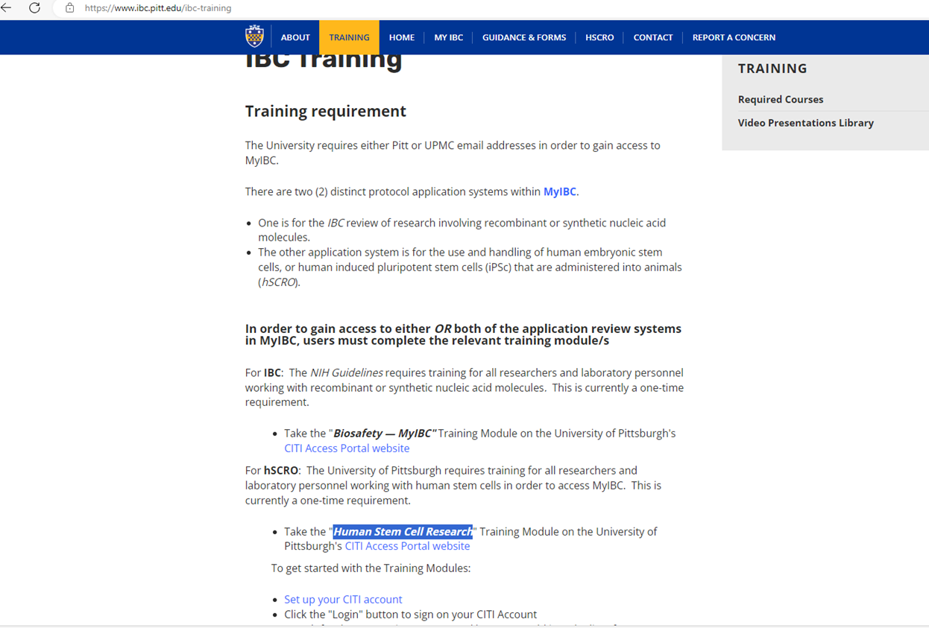

Other topics
Stem Cell (hSCRO) Approval
Training Video Session 1- Stem Cells

Slide 18
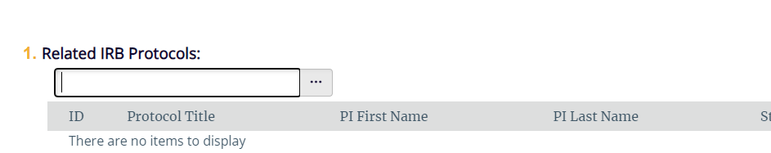
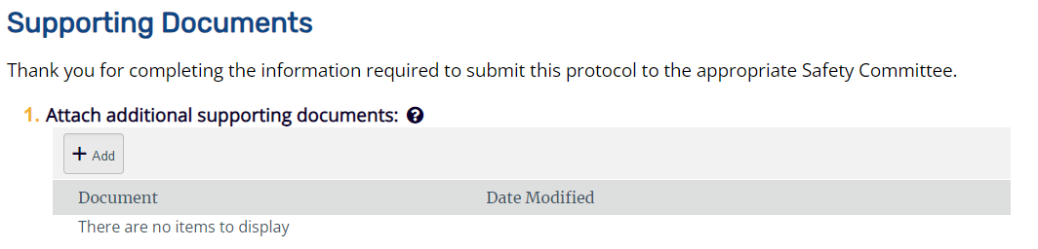
Human Gene Transfer Studies
Clinical Trials Using rDNA study agents
Video Training Session 10

Slide 19
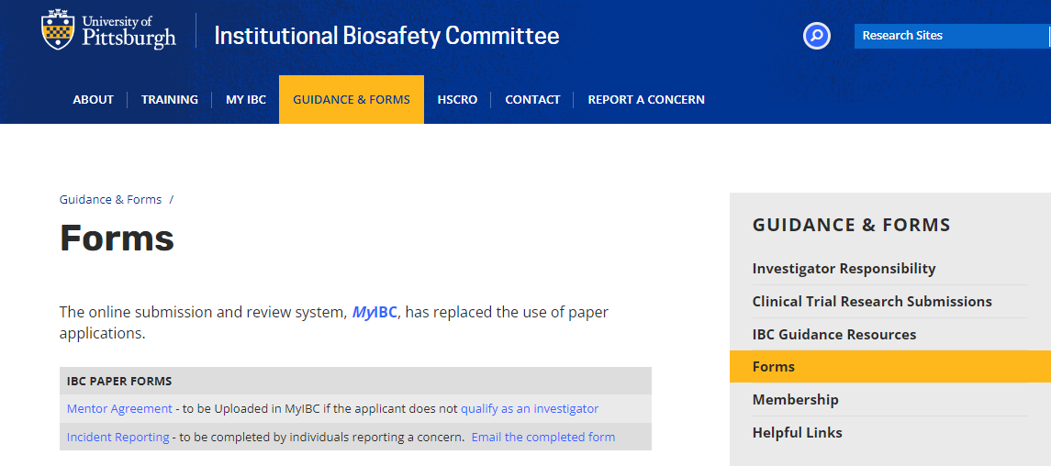
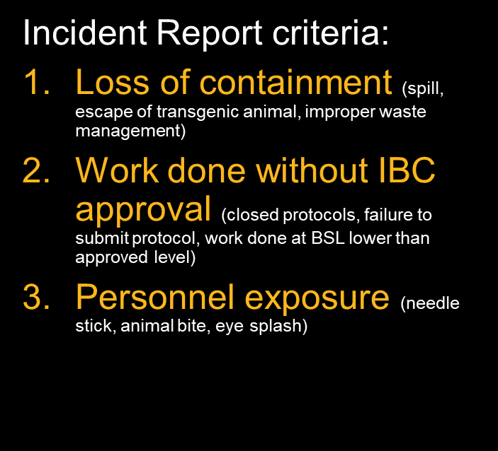
Incident Reports
Video Training Session 9
NIH Office of Science Policy Guidelines require rDNA exposures be reported

Slide 20
EH&S based IBC protocols
Wild-Type (WT) agents only
Primary cells, WT viruses and bacteria
"EH&S only" review process

Slide 21
Biosafety Manual and Laboratory Inspections
Biosafety Manual
Required only for BSL-2+ or higher work
Template, review, and approval –EH&S
Attached to IBC protocol in Supporting Documents
Laboratory Inspections
EH&S facilitates
Should be initiated before IBC protocol submission
EH&S inspection required for BSL-2+ or higher Approval

Slide 22
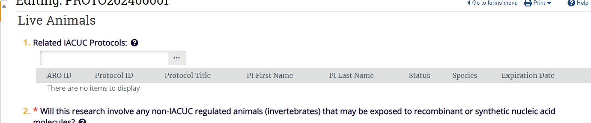
Linking IACUCs
Click on “…” for search options
Only those listed on an IACUC can “see” the IACUC
IACUC’s in pre-submission/under review will show up
Piggybacking:
Not advised
ALL personnel on piggybacked IACUC MUST be listed (and kept up to date) on the IBC. Their work with rDNA materials is the responsibility of the IBC PI

Slide 23
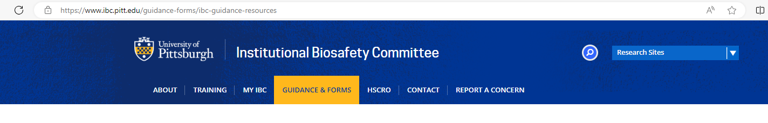
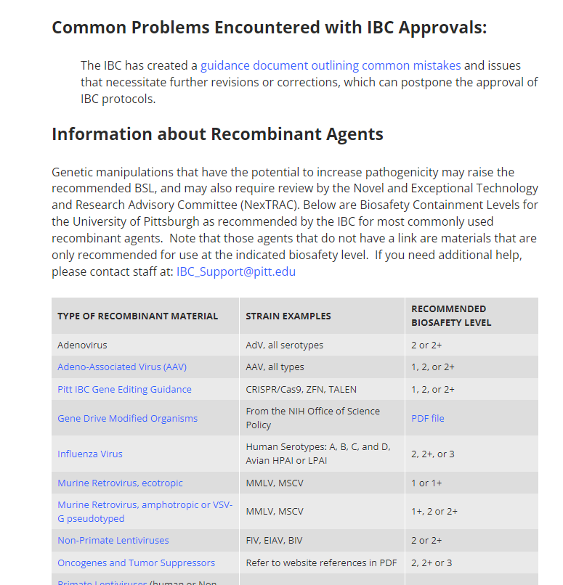
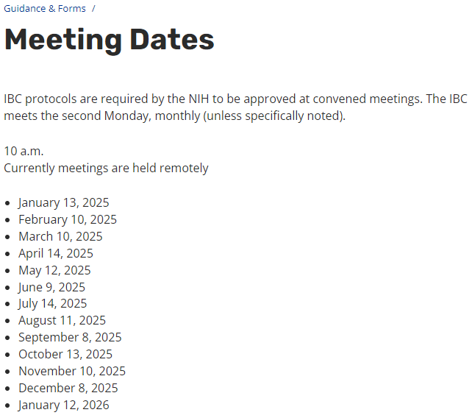
IBC Resources

Slide 24
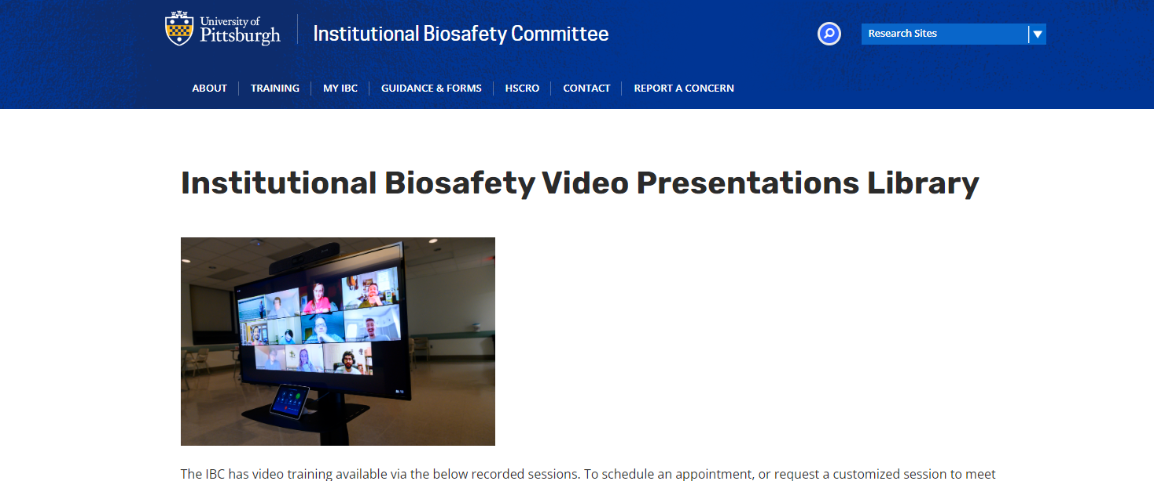
Institutional Biosafety Division
Director
Beverly Harding, MSL
Staff
Theresa Bodnar
Kristine Cihil, MPPM, MSL
Contacts
ibc.pitt.edu
ibo@pitt.edu
ibc_support@pitt.edu
Main Office #
412 383-1768

